Slide 1
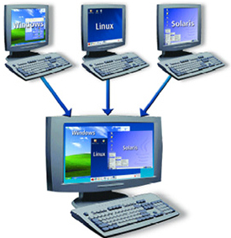
Containers
Docente: Dott. Daniele Gobbo Modulo 1

Slide 2
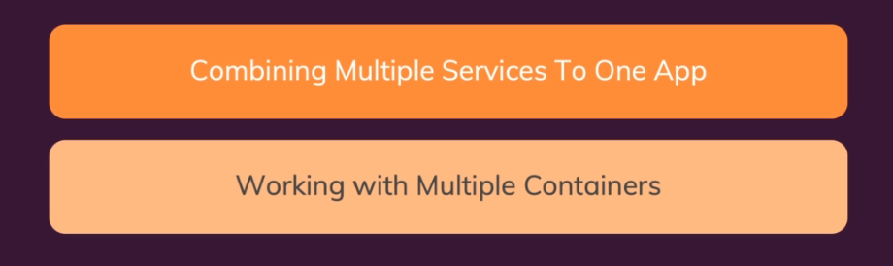
BUILDING MULTI-CONTAINER APPLICATIONS

Slide 3

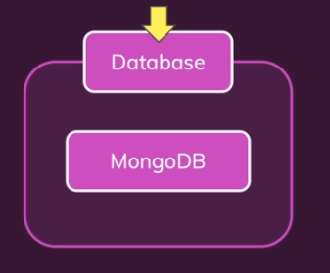
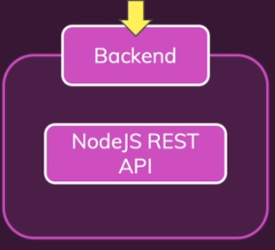
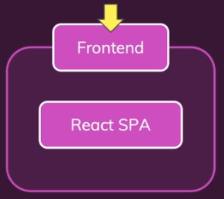

OUR TARGET APP & SETUP
In general though, this is a pretty common setup or a pretty common way of building a modern web application and it's pretty common to split it like this, to have a database and to then have backend web server which is not directly used by the end users visiting your website, but instead you have this front end web application which is responsible for bringing something on to the screen of your users so which is responsible for rendering the actual HTML code they see and then it's this front end which talks to the backend
PLEASE open in visual studio code 7-multi-01-starting setup folder

Slide 4
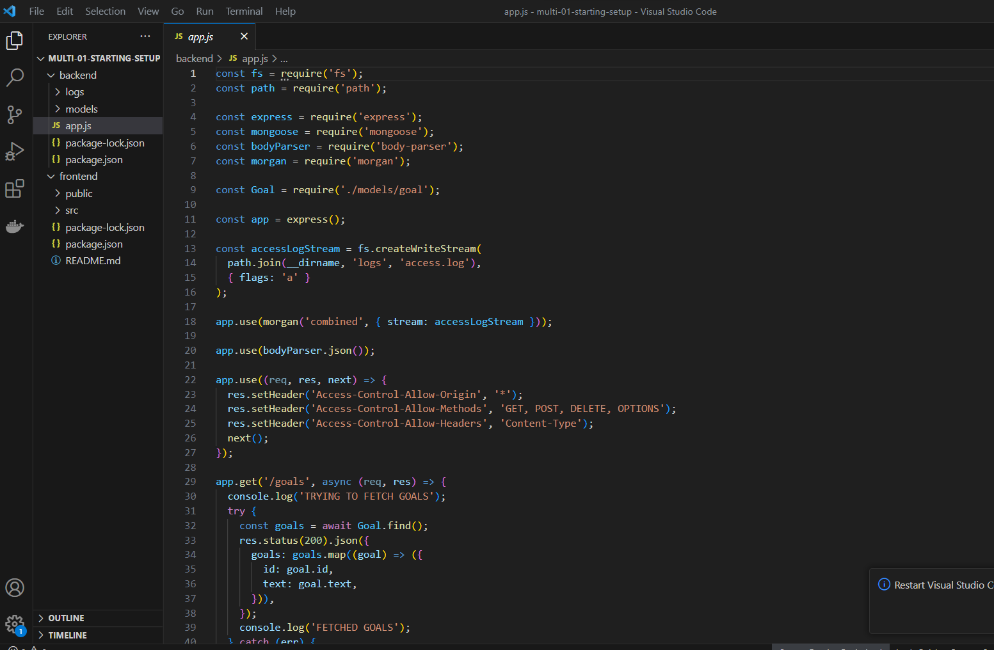
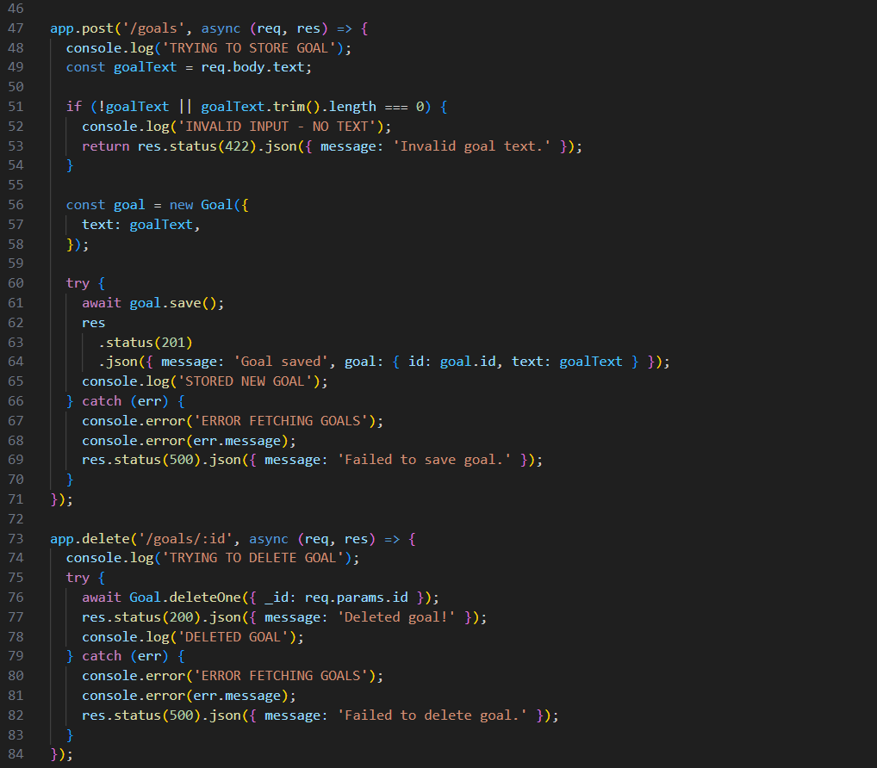
OUR TARGET APP & SETUP-BACKEND
This backend folder which contains a Node.js application built with Node and Express and this application in the end just takes in a couple of requests that allow users to set and see and delete goals because we're going to build a demo application here where users can track their goals.
These goals are then stored in a database.
In addition I also got some logging set up here
where some log files are written into a logs folder

Slide 5
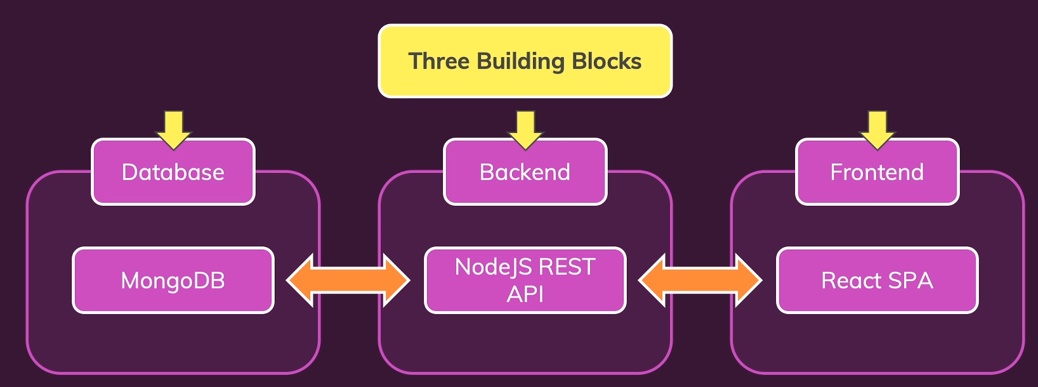
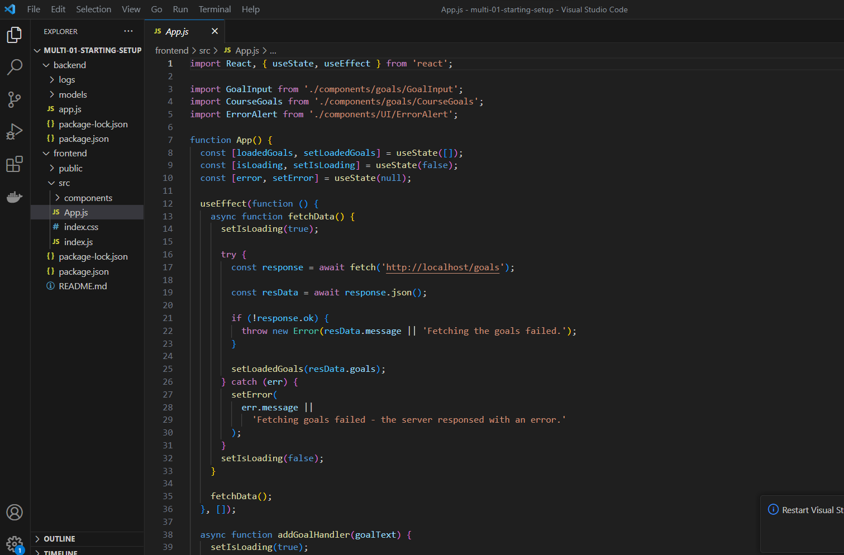
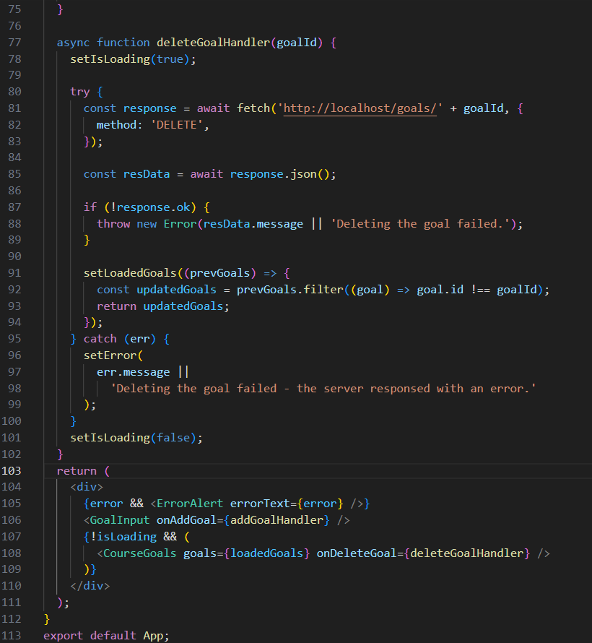
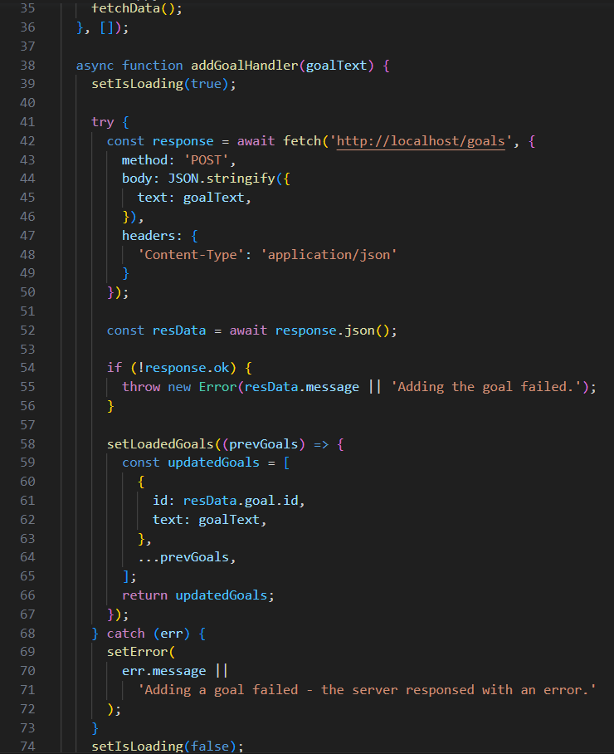
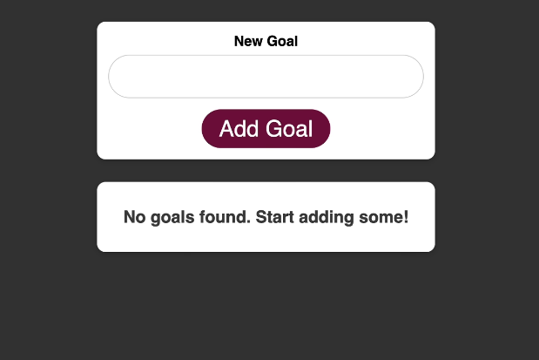




OUR TARGET APP & SETUP-FRONTEND
The front end is a React application.
React is a JavaScript library which runs in the browser, not on a server.
Node runs on a server.
React, this JavaScript code runs in a browser and this React application is detached from the backend here.
It's a stand alone web application which can be hosted on a stand alone server which just communicates to this backend API though
what I'm doing here is I'm just sending a request to my backend API so to this backend server to get the goals stored by a user
or also to add a new goal there or to delete a goal.
And that's basically what this application does.
Which data?
I'm not talking about the goals.
These are getting stored in the MongoDB database so that's not something the Node API needs to persist, but I'm talking about these log files which are written.
These are actual files written to this logs folder and they are into this file and this file should not be deleted
The data of course should persist.
It should not be lost if the MongoDB container
is removed and then recreated.
running React application on localhost 3000.
The Node API is running on a different port.
This is running on port 80
So we have two separate development servers,
two separate web servers here
running in backend and front end.

Slide 6
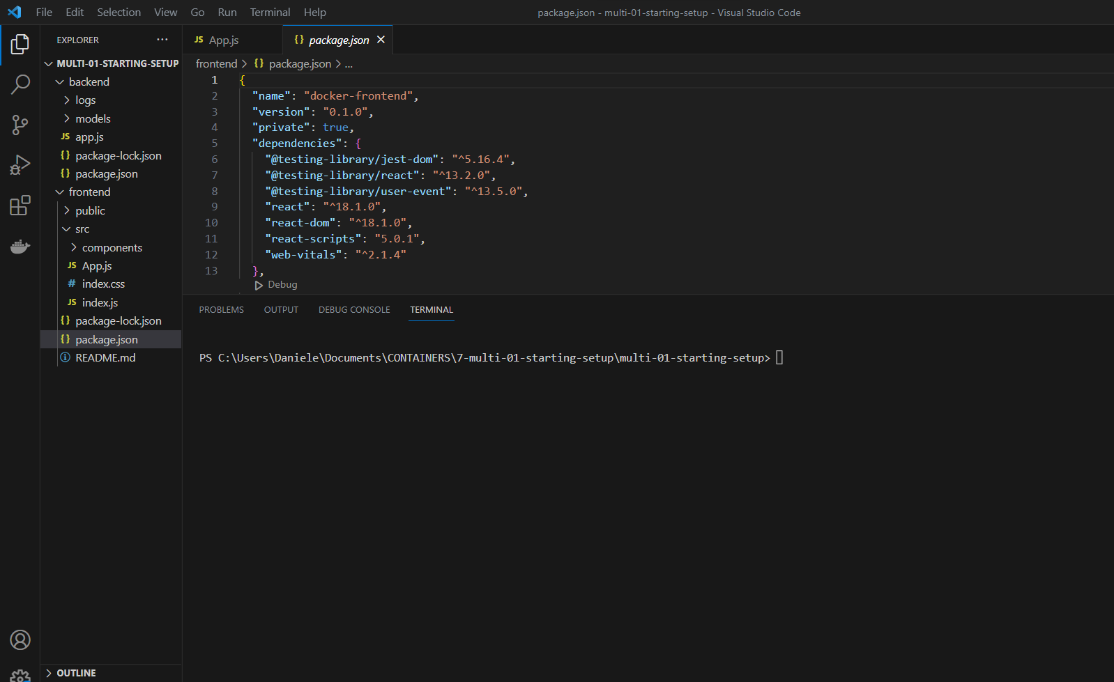
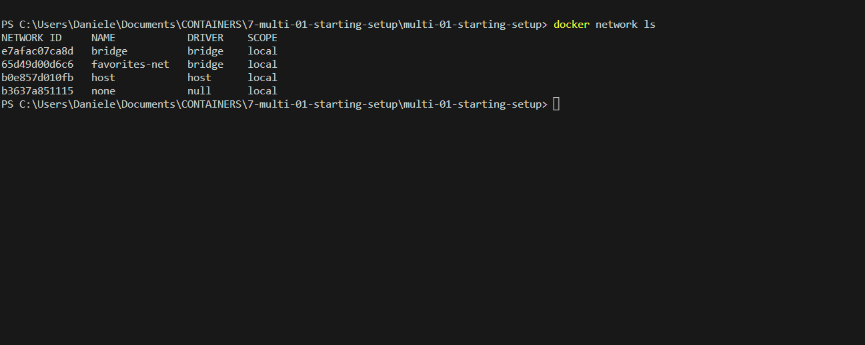
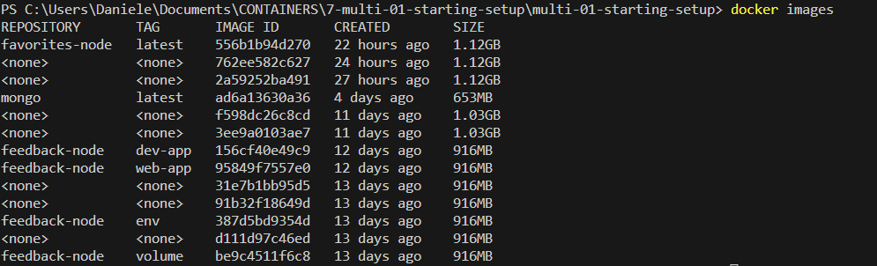
CREATE NETWORK FOR DOCKER APP
PLEASE REMOVE ALL EXISTING IMAGES AND CONTAINERS

Slide 7
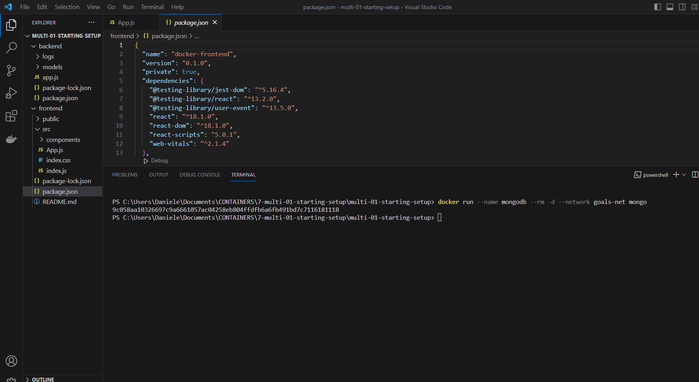
CREATE MONGODB CONTAINER

Slide 8
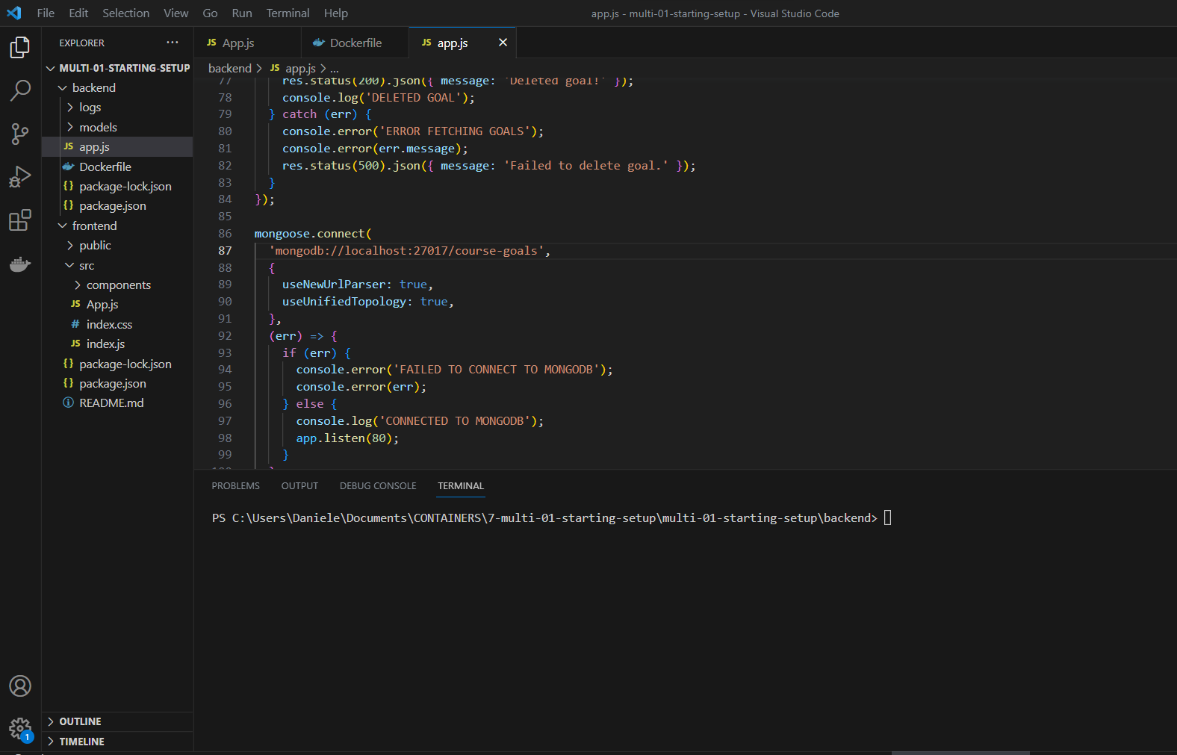
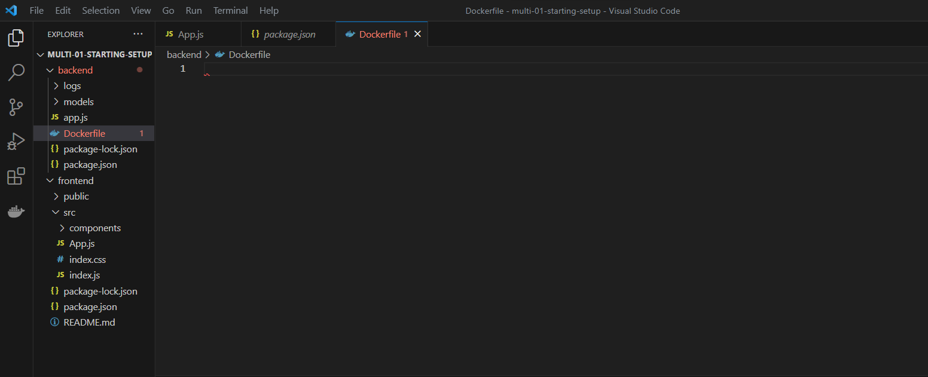
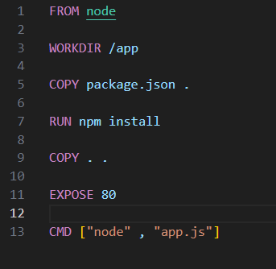
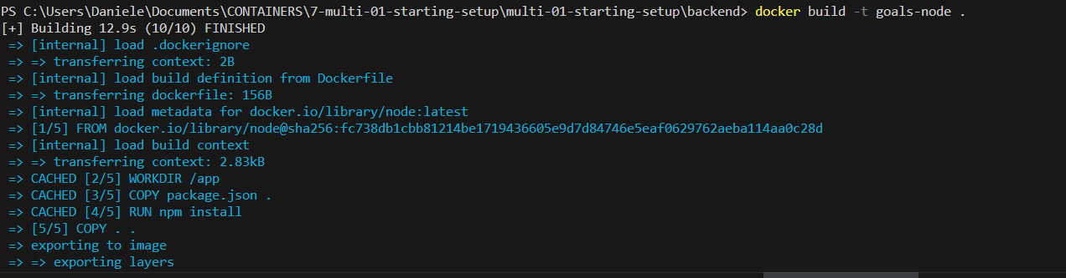
CREATE BACKEND CONTAINER

Slide 9
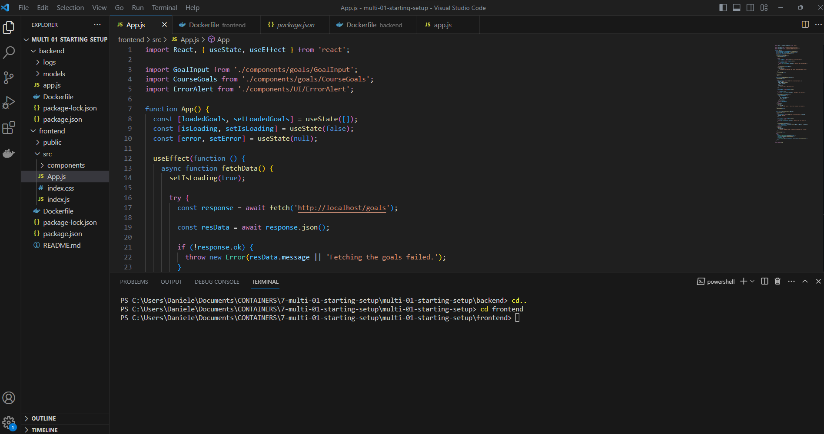
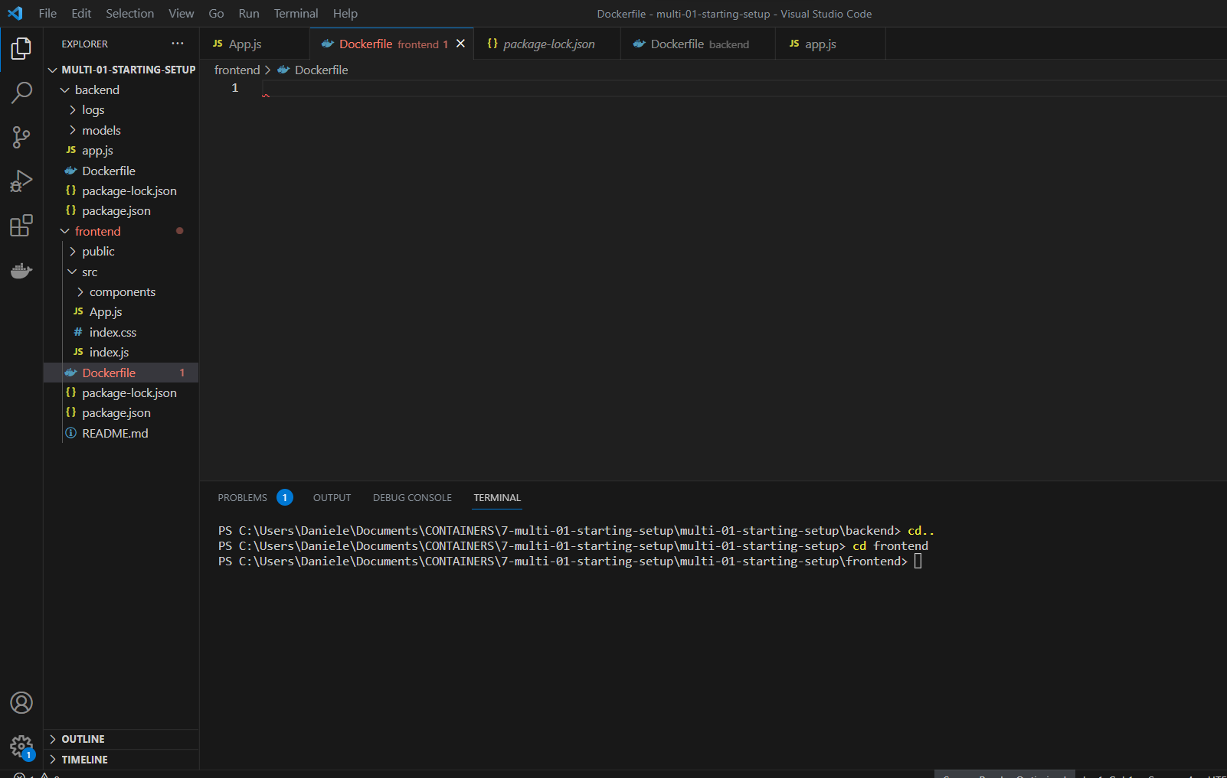
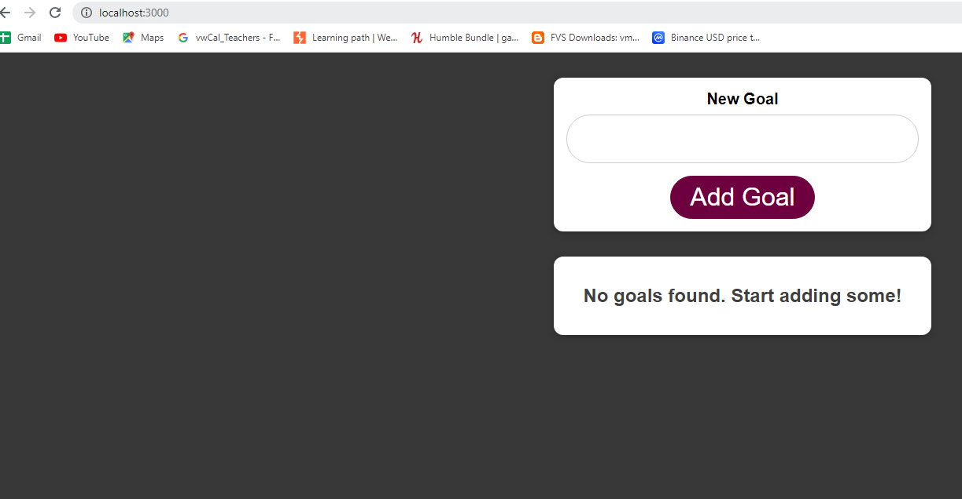
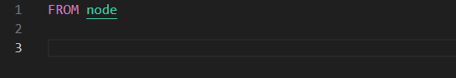
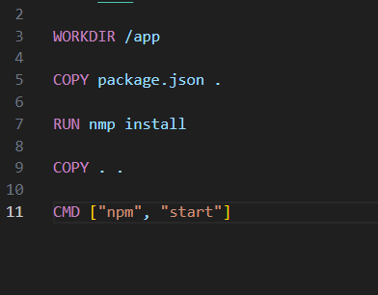

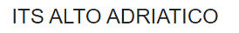

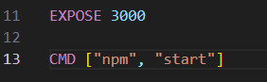
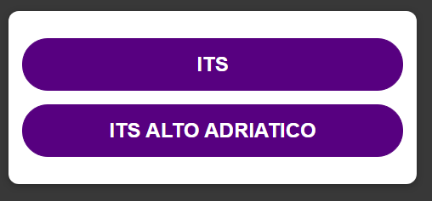
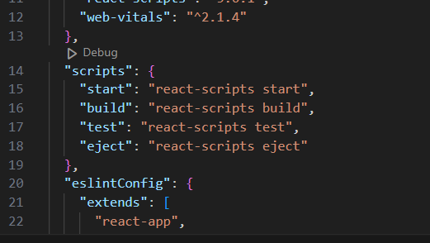
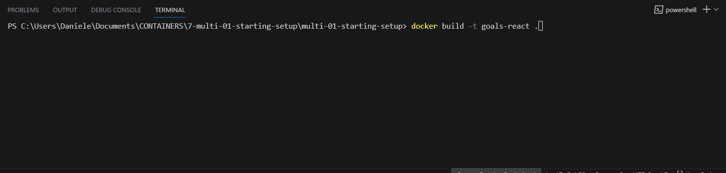
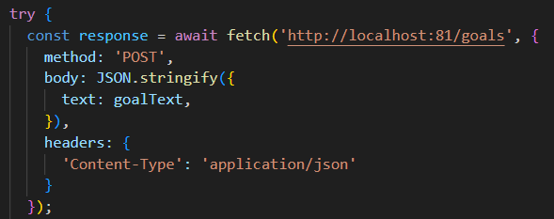
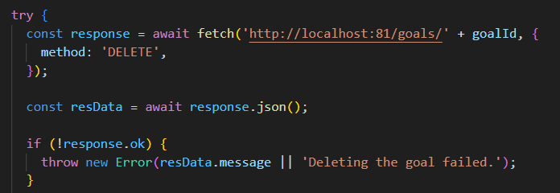
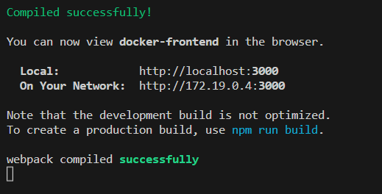
CREATE FRONTEND CONTAINER- Moving the REACT SPA into a container
Now, in order to dockerize it,
you need some basic knowledge
about this React project setup:
You need to know that this frontend setup depends on Node.
It's not a Node application, but it uses Node to spin up this development server, which serves this React application, and Node is also used to optimize the React code which you write and to transform it into code the browser understands.

Slide 10
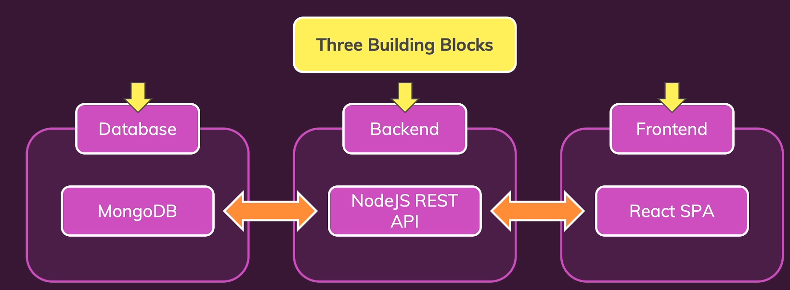

PROJECT

Slide 11
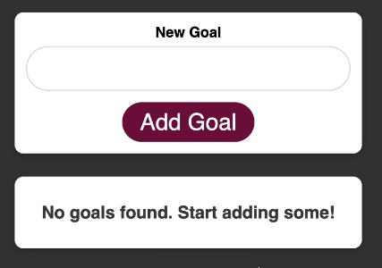
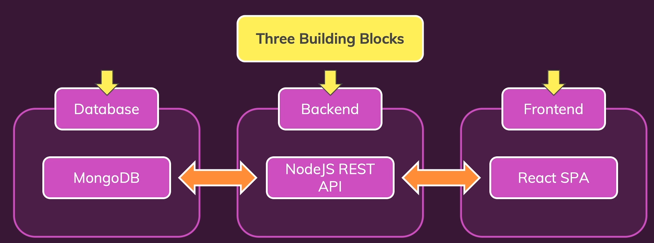
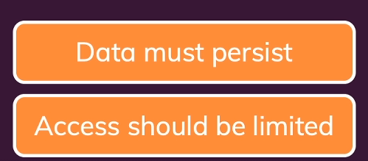
ADDING DATA PERSISTENCE TO MONGODB WITH VOLUME
We can add a volume.
We do this with the -V flag
REMEMBER THAT MONGODB STORE DATA ON /data/db folder
If we stop MongoDB and then rerun it in the same way as before it works and our application will be able to talk to it, but the goal is gone.
It's no longer there.
And that happens because when we stop MongoDB, the container is removed, and when it's removed, all the data stored in the container is lost.
And the data stored in the database, in the MongoDB database is stored in that container of course.
So therefore here, we need to ensure that we detach that data, which in the end is still written to the hard drive.

Slide 12
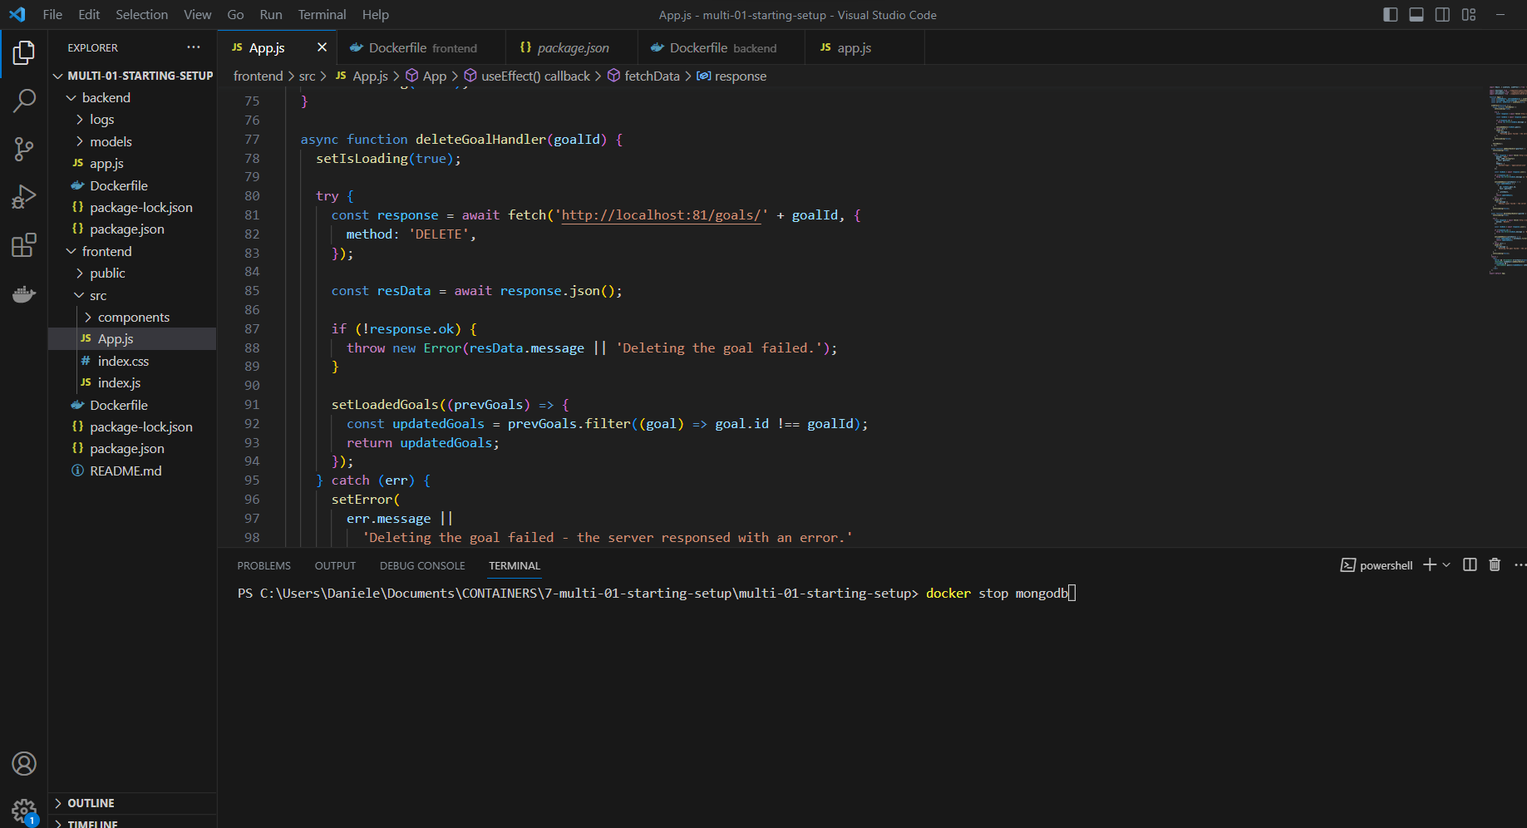
ADDING DATA PERSISTENCE TO MONGODB WITH VOLUME
Docker will then create this volume, if it doesn't exist already and store any data written inside of the container in that volume on the host machine, we just don't know where that is on the host machine.
And if it does exist already, Docker will load the data that's already in that folder on the host machine, into that folder in the container.
And this then ensures that our data is never lost.

Slide 13
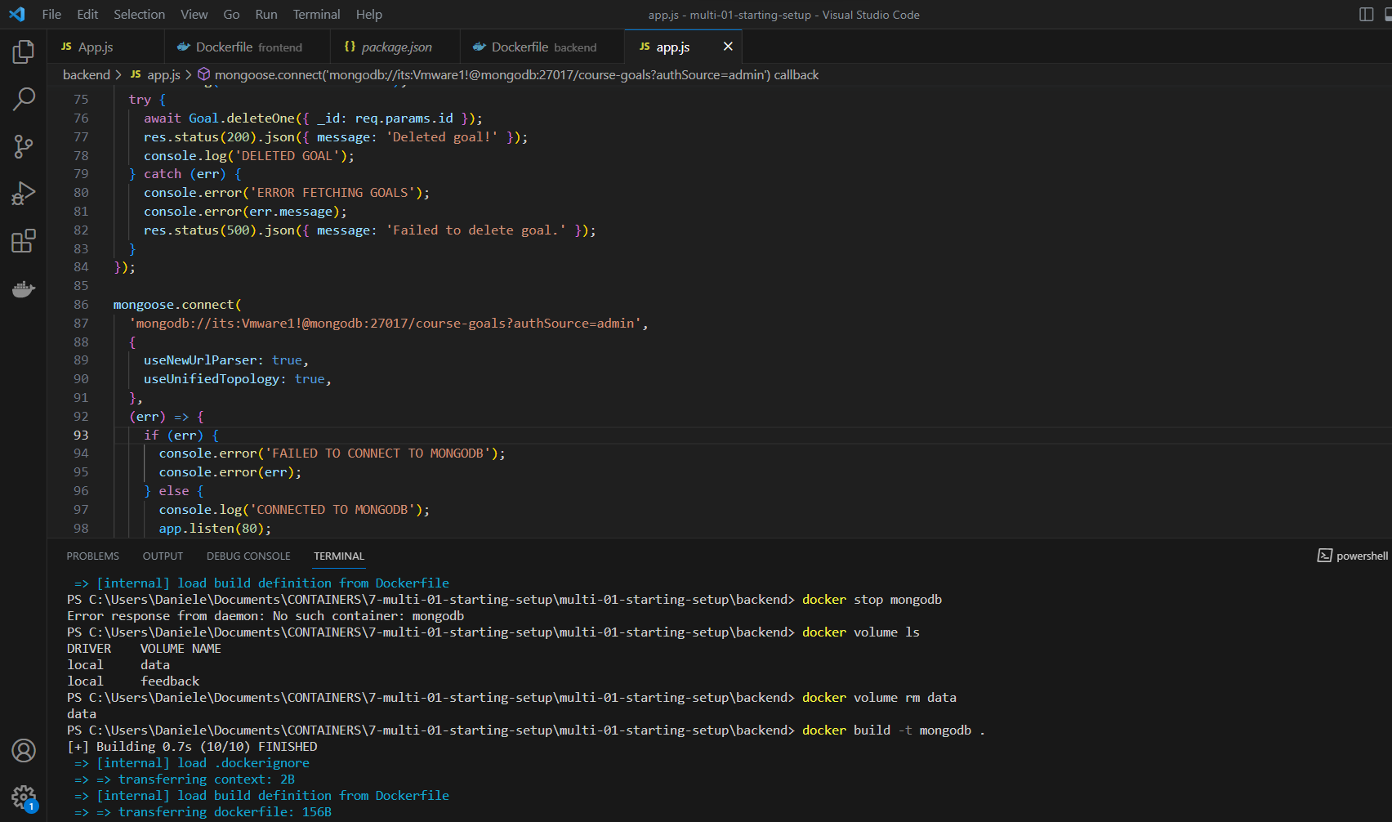
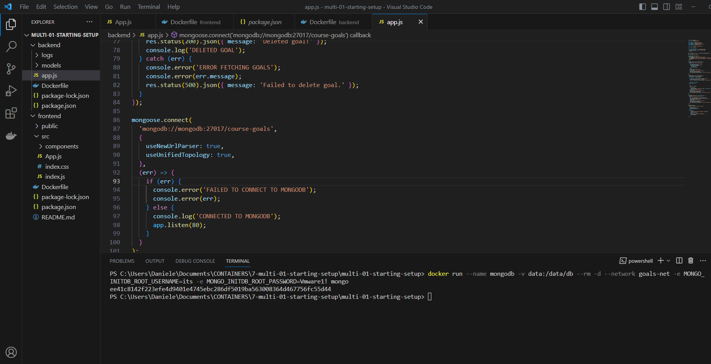
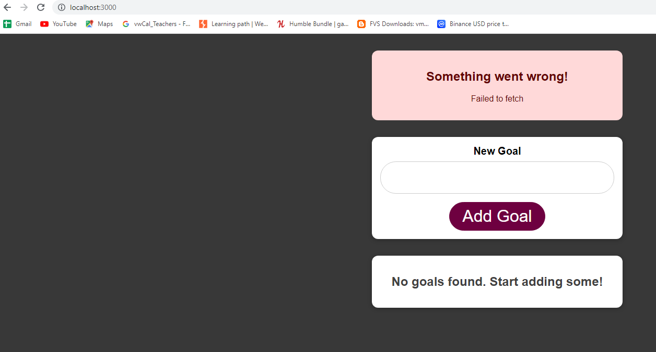
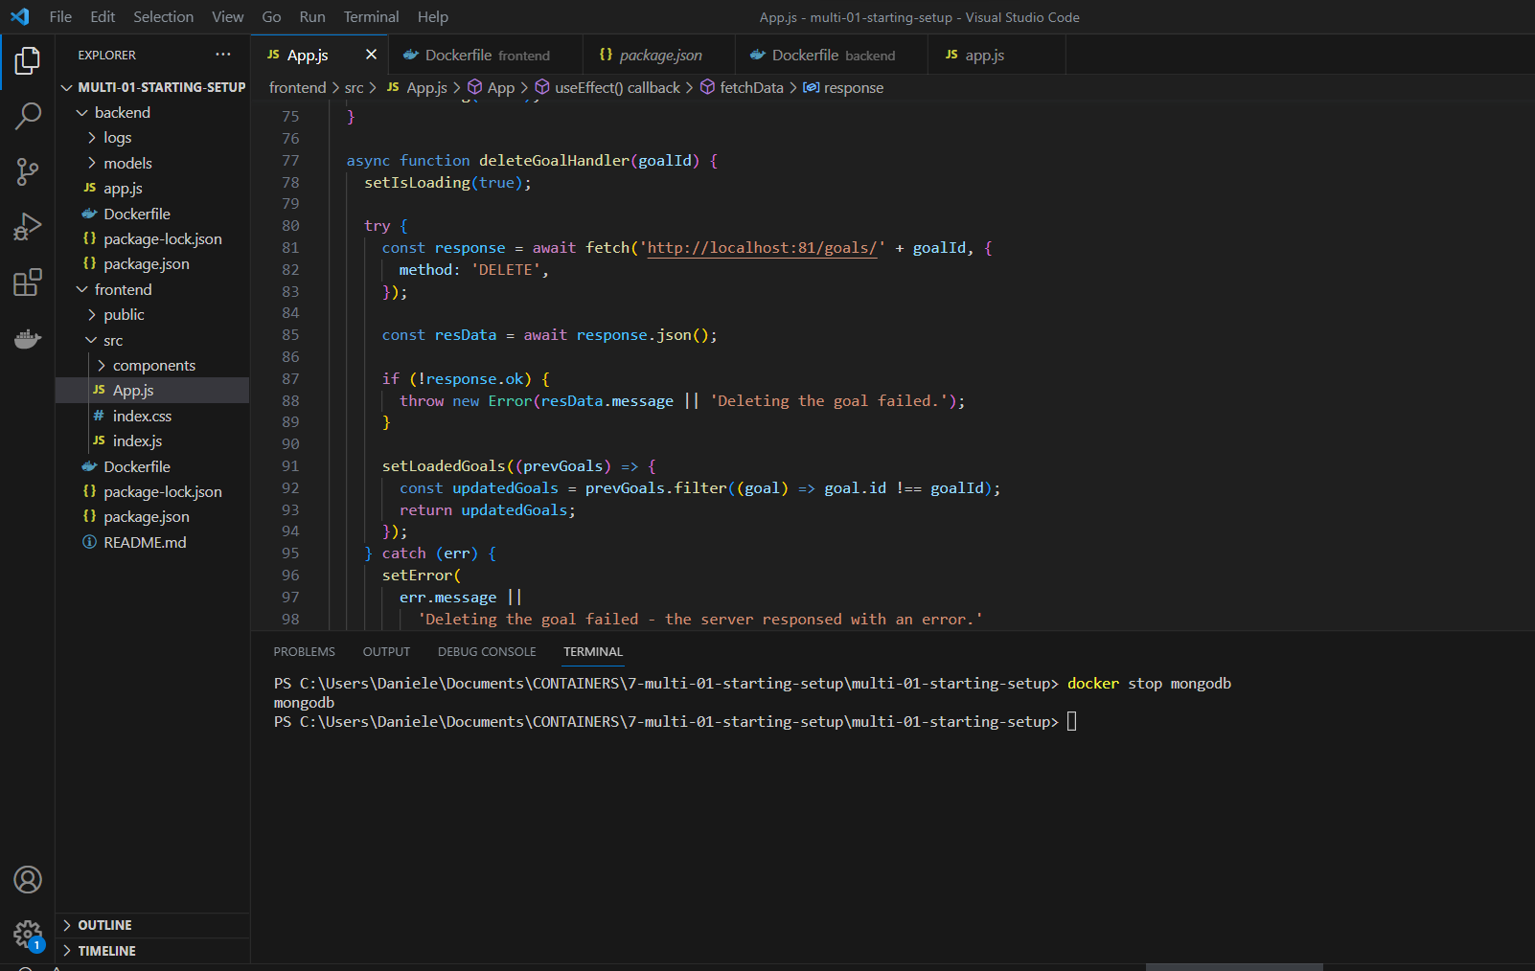
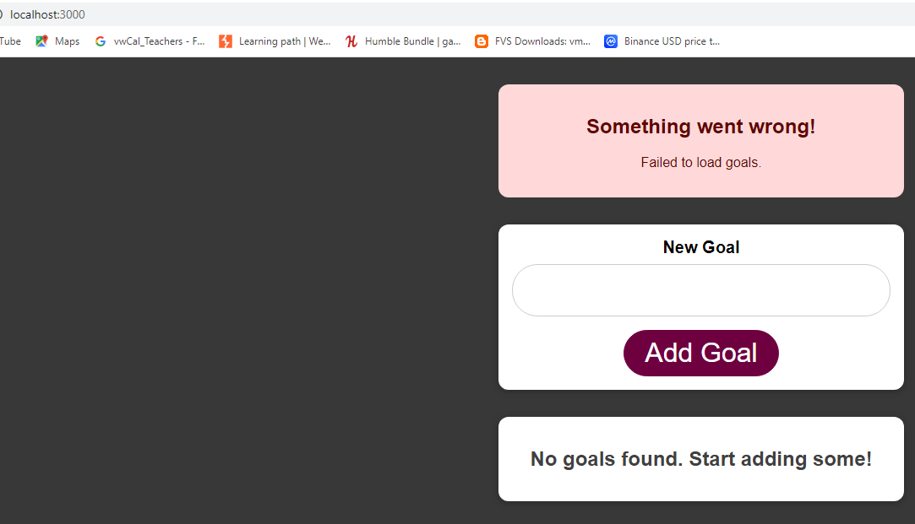
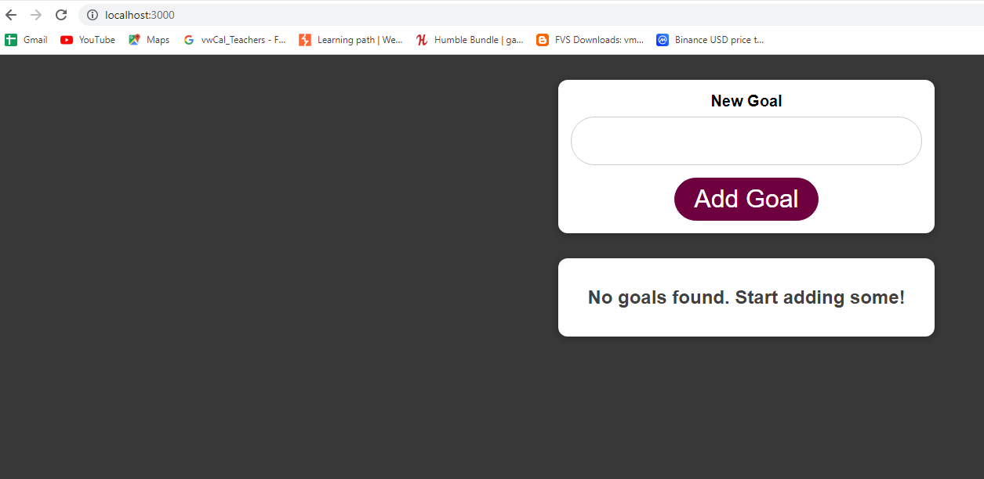
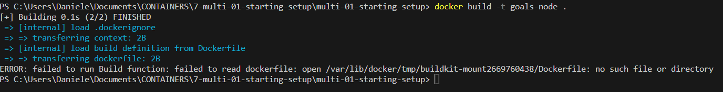
APPLY SECURITY TO MONGODB
Now another requirement was security and preventing access to our database.
And for that the MongoDB image supports two environment variables:
MONGO_INITDB_ROOT_USERNAME
MONGO_INITDB_ROOT_PASSWORD
And when we use these environment variables, then the database insert at the MongoDB container will be created such that this username and password is required to access it.
The problem could be the volume and the fact that you created another user with different credentials before you changed them. Because of the volume, your database is still there and hence your old root user is still set up - i.e. your old credentials apply.
PLEASE REMOVE “data”VOLUME AND RERUN BACKEND
That fails because the node application, which talks to MongoDB, connected without that password and user and now that database is protected though.
So now we need to ensure that in our app JS file of our node backend, indeed we do utilize that password and username we just used for starting the database.

Slide 14
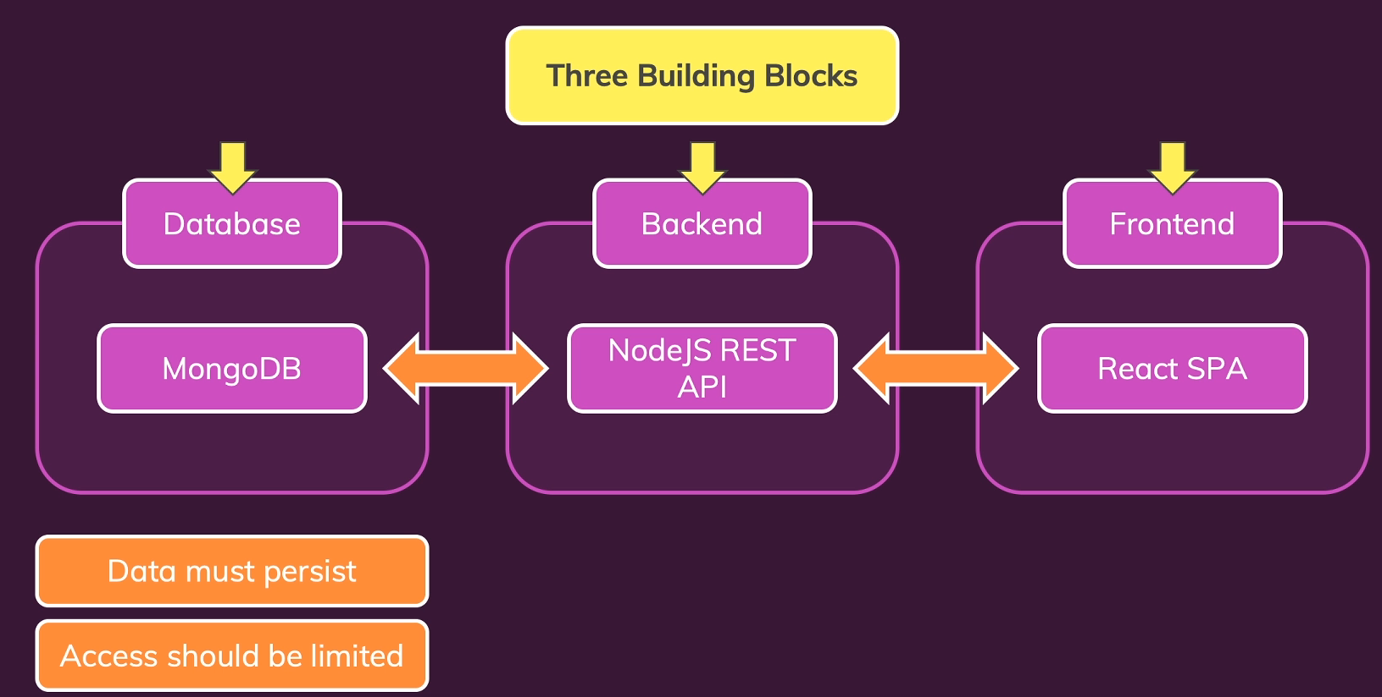


Volumes, Bind Mounts & Polishing for the NodeJS Container
We also want ensure that data persists in this case, the log files, this container writes, and we want have live source code updates so that when we change our source code in our local host project folder

Slide 15
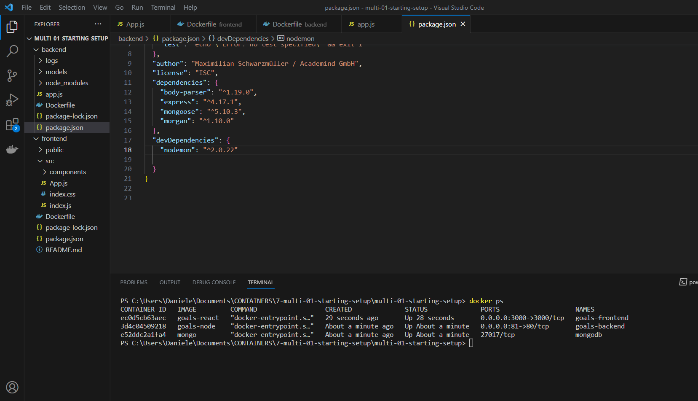
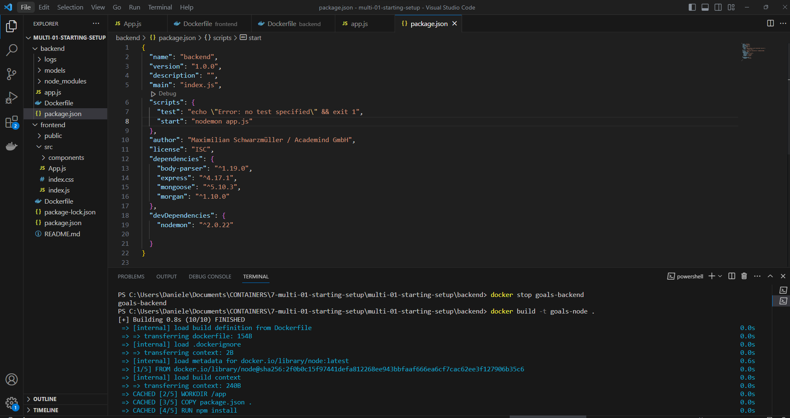
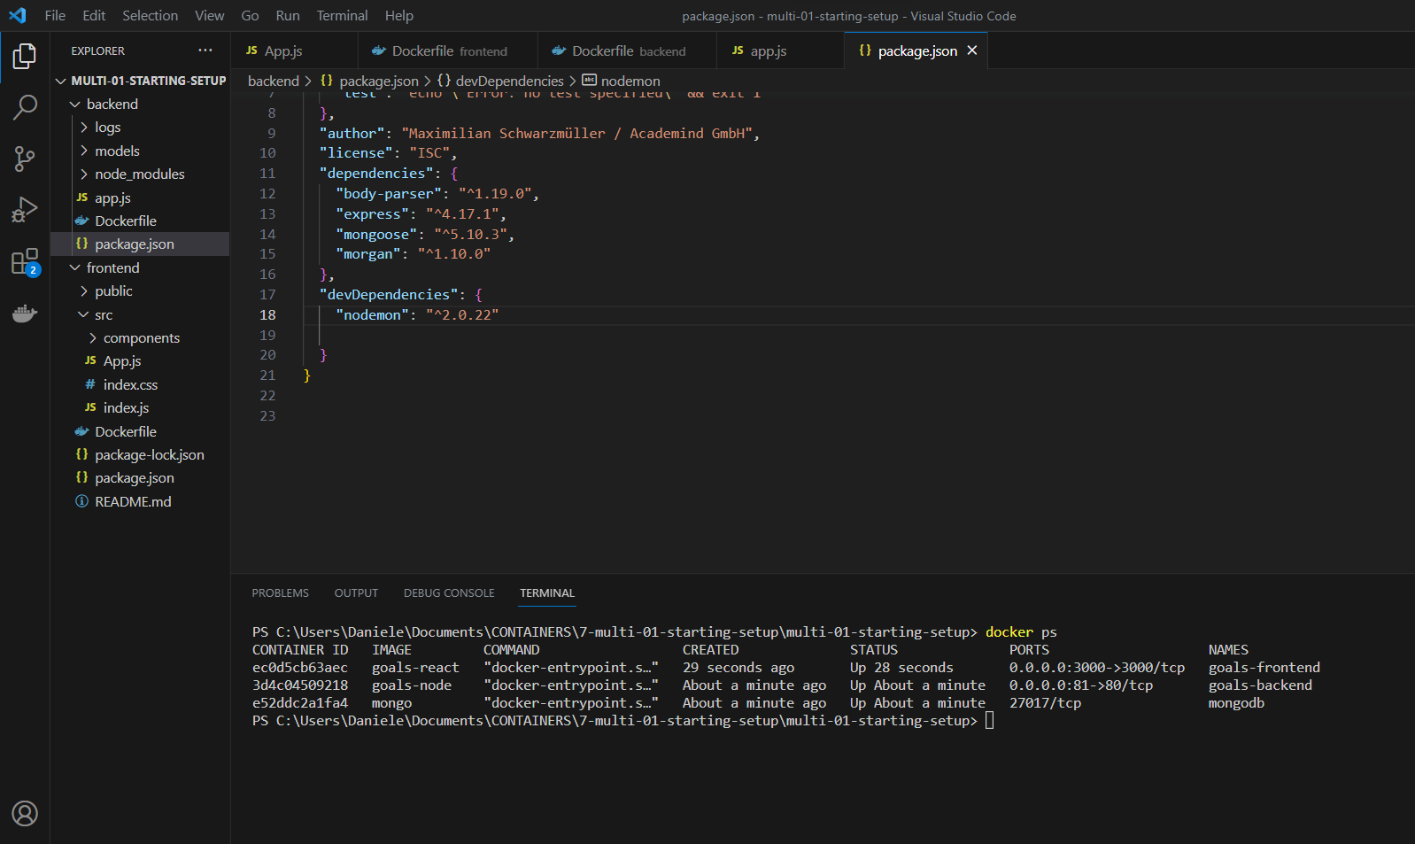
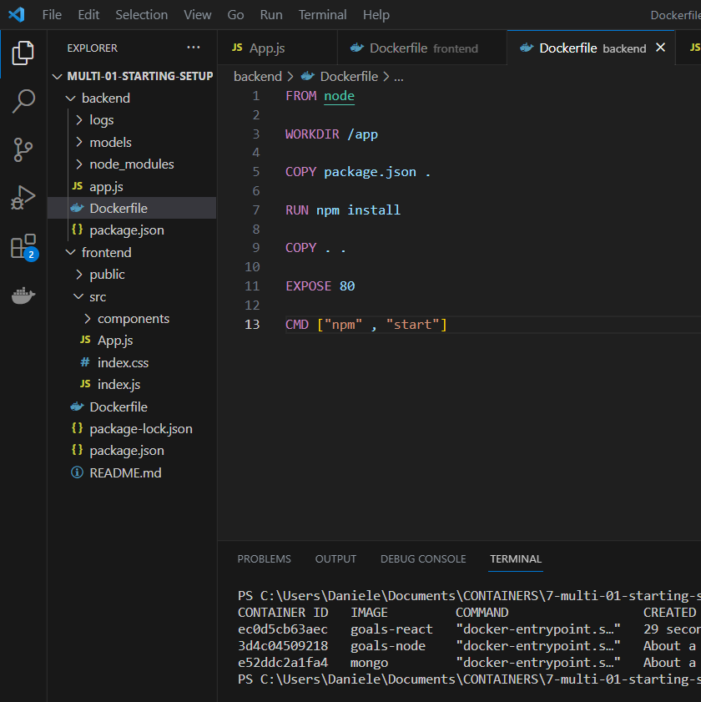






Volumes, Bind Mounts & Polishing for the NodeJS Container
PLEASE ADD THIS CODE HERE…. PAY ATTENTIONTO THE COMMA SYMBOL
PLEASE DELETE PACKAGE-LOCK.JSON file
ARE WE READY FOR LIVE UPDATE?
NO……
Now we do put only our latest source code from the local host folder into the node container, but currently that doesn't do much because when we start the container, we run app.js with the node command.
The node process loads all the code, and then starts that code.
So, if the code changes their author, this has no impact on the already running node server.
And that's of course not what we want here. We want the node server to restart whenever the code changes.
We can add the extra dependency to this project, which then actually will restart the server automatically for us when the code changes.
Nodemon is an extra tool, which watches the project folder for file changes in JavaScript files,
and if such a JavaScript file does change, it restarts the node server.
We just have to ensure that to utilize nodemon,
we can do that by adding a start script here
But we also learned that we should do something similar about node modules to ensure that if we didn't have node modules here on the local host machine, we don't overwrite the existing node modules in the container with the non-existing ones here, which would cause our container to crash because dependencies would be missing.
we can simply use an anonymous one and point at app/node_modules
to basically tell the container that the existing node modules folder inside of the container should stay thereand should not be overwritten by the non-existing node modules folder in our host machine folder
I want bind everything in the app folder to my local hosting directory here, simply to ensure that whenever I change something
in my source code here, it's reflected inside of the container.
Now also keep in mind what you learned about volumes and files overwriting each other in the container.
Longer container internal paths have precedents and overwrite shorter paths. So in the example of logs here, we already do ensure that logs written by the container are not overwritten by the local logs folder in my local host project folder.So that's good. The logs in the container will survive.
We need one volume for the log files. Now we can go for a name volume to not know where they are stored on the host machine,
but to ensure that they survive container tear down.
We now need to run this start script,
and can start like this to utilize nodemon.

Slide 16

Create Dockerignore file
There is one last thing I wanna take care of.
At the moment, thanks to the docker file,
I copied everything from this backend folder
into the container (COPY . .), after the dependencies have been installed in there (COPY package.json .).
This is okay, but there are files I'm copying
into the container, which I might not wanna copy in here.
And for that, I'll add a .dockerignore file.

Slide 17







LIVE SOURCE CODE ON FRONTEND CONTAINER
So now I wanna start this frontend container,
such that my source code is provided in there
and changes are picked up automatically.
(bind mount).
I don't need any data persistence or anything like that,but that bind mount would be nice to have
We don't need nodemod here because this project uses is already configured to react to file changes and rebuild the application.
Please press CTRL+C twice to stop frontend
Now if I change something…….

Slide 18

LIVE SOURCE CODE ON FRONTEND CONTAINER

Slide 19



Create Dockerignore file
Please press CTRL+C to exit frontend application
this now was faster than before

